Slide 1
Business Process Modelling and Enterprise Architecture
&
Advanced Information Systems Development
Introduction
Dilshan Jayatilake

Slide 2
Session Plan
Teaching Team
Unit overview
Learning Outcomes
Delivery Plan
Assessment Overview
Q&A

Slide 3

Teaching Team
Dilshan Jayatilake
Lecture Lecturer in Computer Science
  Contact
    Email: dilshan.jayatilake@uwe.ac.uk
    Book a Meeting: Meeting Link
David Wyatt
  Senior Lecturer in Computer Science
  Contact
    Email: David2.Wyatt@uwe.ac.uk
Rumali Sirimanne
  Associate Lecturer in Information Science
  Contact
    Email: Rumali.Sirimanne@uwe.ac.uk
Rumali Sirimanne
  Associate Lecturer in Information Science
  Contact
    Email: Rumali.Sirimanne@uwe.ac.uk

Slide 4
Teaching Team
Teaching Assistant
  Julia: maqifeng@nuit.edu.cn
  Ken: oujianbin@nuit.edu.cn

Slide 5
Units overview
Business Process Modelling and Enterprise Architecture (BPM&EA)
  Unit ID: IN3344
  Number of Learning outcomes: 3
  Duration: 6 Weeks
Advanced Information Systems Development (AISD)
  Unit ID: IN3345
  Number of Learning outcomes: 6
  Duration: 6 Weeks

Slide 6
Learning Outcomes BPM&EA
  L1 - Explain and evaluate the architecture of contemporary applications
  L2 - Evaluate designs in terms of form, context, ensemble, multiple form-context boundaries and fitness
  L3 - Analyse and model information systems and applications effectively using patterns, frameworks and constraints

Slide 7
Learning Outcomes AISD
L1 - Understand the different contexts for Human Computer Interfaces and be able to define a user-centred design that explicitly recognises the user and is Disability Discrimination Act compliant
L2 - Create and specify a software design for a medium-size software product using a software requirement specification, an accepted program design methodology and appropriate design notation
L3 - Understand and critically evaluate the project management processes and their relationship to systems development method and practice; including stakeholder requirements analysis, planning, estimating and risk
L4 - Understand and manage version control, security, legacy and implementation as they relate to the development, delivery and operation of Information Systems
L5 - Determine appropriate testing strategies; create, evaluate, and implement test plans; develop and execute test scripts and assess test results
L6 - Explain, select and apply the principles, standards and techniques of quality planning and assurance as they relate to systems development and deliverables

Slide 8
Assessment Overview for Both Units
Assessment Period | Assessment Component | Weight | Type
Main Sit | Coursework | 50% | Group Based
 | Presentation | 50% | Group Based
Re-Sit | Coursework | 50% | Group Based
 | Presentation | 50% | Group Based

Slide 9
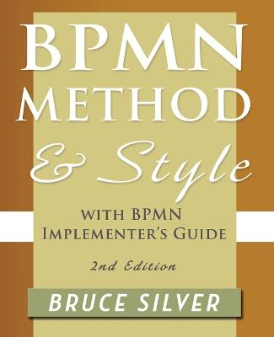
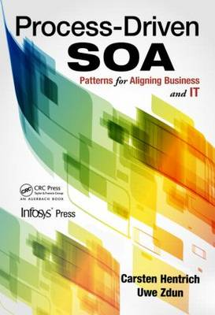
Recommended Readings
BPMN method and style: with BPMN implementer's guide - Bruce Silver
Real-Life BPMN Book Excerpt | Camunda BPM
Process-driven SOA: patterns for aligning business and IT - Carsten Hentrich; Uwe Zdun
Advanced microservices: a hands-on approach to microservice infrastructure and tooling - Thomas Hunter
BPMN method and style:
with BPMN implementer's guide - Bruce Silver
Process-driven SOA: patterns for
aligning business and IT –
Carsten Hentrich; Uwe Zdun

Slide 10
Syllabus co-development
Suggested Topics
UML Related Topics
  Physical View (Components Diagrams, Deployment Diagrams)
  Processes View (Activity Diagrams, Sequence Diagrams)
  Logical View (Class Diagrams)
Java Based
XML Related
  XSLT
  XML Schemas
  XML and DOM
Web Services
  SOA Delivery Strategies
  Services, Orchestration and Choreography
Patterns to systems development
  Enterprise application patterns
  SOA patterns

Slide 11

Questions

Slide 12
Business Process Modelling and Enterprise Architecture
&
Advanced Information Systems Development
Introduction
Dilshan Jayatilake

